Slide 1
Attention Deficit Hyperactivity Disorder (ADHD)
Name
Professor
Course Title
Date

Slide 2
Overview of ADHD
A person with ADHD exhibit differences in brain development than normal individuals.
A mental disorder of the neurodevelopmental type.
Disruption of brain activity that affect cognition, self control, and ability to sit still.
Characterized by doing things with no regard for consequences.
Children with the disorder have problems at home, in school, in friendships.
Patients also have a challenge managing emotions.
Notes:
ADHD stands for attention deficit hyperactivity disorder. It is a medical condition. A person with ADHD has differences in brain development and brain activity that affect attention, the ability to sit still, and self-control. ADHD can affect a child at school, at home, and in friendships (Giacobini et al., 2018).

Slide 3
Signs & Symptoms if ADHD
Three categories of symptoms: inattentiveness, hyperactivity, and impulsiveness.
Inattentiveness; patients are easily distracted, unable to focus or concentrate on a task.
They may not listen well; miss crucial details; end up not finishing what they started.
Appear absent minded; forgetful, and lose track of their tasks
Hyperactivity; patient is ever restless; always fidgeting; trouble staying or quiet; make careless mistakes; act in ways to disrupt others even when they do not intend to do it.
Impulsiveness; patient are fast to act without much thought; ever impatient; always interrupt; do things without permission; act in ways that put their life at risk; intense emotional reactions.
Notes:
Park, Hudec, and Johnston, 2018)

Slide 4
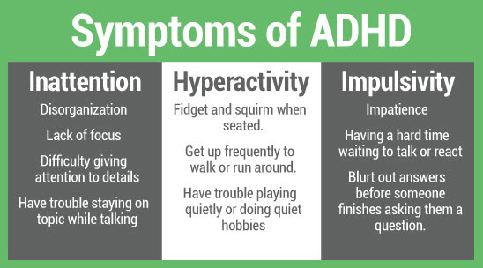
Notes:
https://www.pinterest.com/pin/643874077952485206/

Slide 5
Risk Factors for ADHD
Exact cause of the disorder yet to be clarified.
Regardless, there are risk factors associated with its incidence and prevalence rates.
Premature birth.
Smoking, drinking , and other drugs use during the gestation period
Environmental toxins, for example lead
Genetic inheritance.
Notes:
Mogavero et al., 2018

Slide 6

Complications
Kids tend to have poor self-esteem
Struggle in class; academic failure; discrimination by other kids and adults.
More injury and accident prone than children without the condition.
Often have trouble interacting and being accepted by their peers.
Notes:
https://www.google.co.ke/imgres?imgurl=https%3A%2F%2Fscontent-mxp1-1.cdninstagram.com%2Fvp%2F7b672428124821c862f5a4c3fb4de6ee%2F5D699583%2Ft51.2885-15%2Fe35%2F49380788_516247455547240_391828208998709931_n.jpg%3F_nc_ht%3Dscontent-mxp1-1.cdninstagram.com%26ig_cache_key%3DMTk1NTQ4MzYxNDg1NTU0NTI4MA%253D%253D.2&imgrefurl=https%3A%2F%2Finstogram.pro%2Ftag%2Fshatterstigma&docid=Fn2Ug_EtZecXNM&tbnid=jhcHcukFHrV_1M%3A&vet=10ahUKEwjh2dnBhsXlAhUOAGMBHQ8DCusQMwgoKAAwAA..i&w=320&h=305&itg=1&hl=en-KE&bih=646&biw=1171&q=math%20is%20difficult&ved=0ahUKEwjh2dnBhsXlAhUOAGMBHQ8DCusQMwgoKAAwAA&iact=mrc&uact=8

Slide 7
Diagnosis of ADHD
A set number of criteria used during diagnosis of the disorder.
3 subtypes of the disorder as defined by the American Psychological Association in the DSM;
  ADHD predominantly inattentive type (ADHD-PI)
  ADHD, predominantly hyperactive-impulsive type
  ADHD, combined type
The subtypes are based on the presence of at least 6 of the 9 long-term symptoms of inattention, hyperactivity–impulsivity, or both (Bied et al., 2017).

Slide 8
Diagnosis Cont…
    To be diagnosed with ADHD, a child must demonstrate the following:
    Continuous symptoms display for at least six months
    Symptoms began before the age of 12
    Symptoms show in different settings i.e. home, school to rule out a behavior being due to a certain environment.
    Symptoms make their daily life difficult in the occupational, academic, and social level.
    Symptoms not better accounted for by another developmental condition.
    Scans can also confirm the disorder.

Slide 9
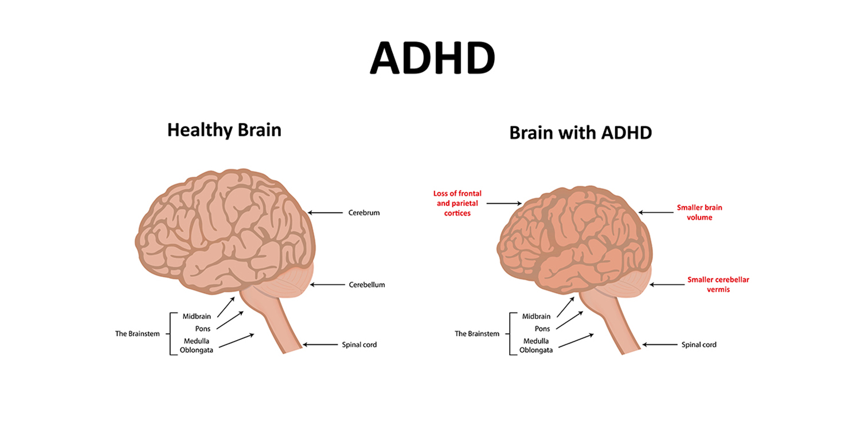
Notes:
https://twitter.com/thedubinclinic/status/988455932496621568

Slide 10
Diagnosis Cont…
Diagnosis more difficult in adults; lack of a consensus on whether the list of symptoms used for children should be used in adults.
Diagnosis in adults require moderate effect on different facets of life including:
  Dangerous driving.
  Difficulty interacting and making friends.
  Poor performance at work and in school.
  Difficulties in relationships with their spouses.
Notes:
For an adult to be diagnosed with ADHD, their symptoms should also have a moderate effect on different areas of their life, such as:
underachieving at work or in education
driving dangerously
difficulty making or keeping friends
difficulty in relationships with partners

Slide 11

Notes:
http://edmontonadhd.com/wp-content/uploads/2013/08/adhd-in-adults-s4-photo-of-distracted-man-at-work.jpg

Slide 12
Neurotransmitter System Associated with ADHD
ADHD characterized by a higher concentration of dopamine transporters called re-uptake inhibitors.
When dopamine is removed to quickly from the system, it fails to exert its effects sufficiently
Dopamine is typically involved in attention, motivation, mood, and movement.
There is also reduction of two other neurotransmitters; serotonin and Norepinephrine.
Serotonin influences mood, memory, sleep, and social behavior.
Norepinephrine affects attention.
Each of the three subtypes of the disorder exhibit different levels of the neurotransmitters.
Notes:
Nigg & Faraone, 2018)

Slide 13
Treatment of ADHD
Medicine; does not cure but boost the ability to pay attention, slow down, and have more self-control.
Two types of medication; stimulants & non-stimulants
Stimulants: methylphenidate ( e.g. Focalin, Daytrana, Concerta, Ritalin), and amphetamines (e.g., Vyvanse, Dexedrine, and Adderall).
Behavioral therapy: therapists help patients develop attention, social, and emotional planning skills.
Parent coaching; parents learn to respond to the developmental difficulties of their kids and try to help them cope with the condition.
Teachers help the kids to cope with the disorder and develop skills for academic improvement.
Notes:
Vieira de Melo, Trigueiro, and Rodrigues, 2018)

Slide 14
Treatment Cont…
Diet modification also helps manage the disorder.
Supplement with free fatty acids and avoid artificial food colors.
Zinc supplements: studies have associated the disorder with zinc deficiency
Omega 3 fatty acid supplementations
Psychotherapy: children are able to explore their behavioral patterns and learn how to make good choices in future.
Notes:
Vieira de Melo, Trigueiro, and Rodrigues, 2018)

Slide 15
Prevention and Control
Avoid alcohol and drugs during pregnancy.
Limit screen time for children
Protection from exposure to pollutants and toxins

Slide 16
References
Bied, A., Biederman, J., & Faraone, S. (2017). Parent-based diagnosis of ADHD is as accurate as a teacher-based diagnosis of ADHD. Postgraduate medicine, 129(3), 375-381.
(Fleming, G. (2019, August). Why Math Is More Difficult for Some Students. Thought.Co. Retrieved from https://www.thoughtco.com/why-math-seems-more-difficult-for-some-students-1857216
Giacobini, M., Medin, E., Ahnemark, E., Russo, L. J., & Carlqvist, P. (2018). Prevalence, patient characteristics, and pharmacological treatment of children, adolescents, and adults diagnosed with ADHD in Sweden. Journal of attention disorders, 22(1), 3-13.
Mogavero, F., Jager, A., & Glennon, J. C. (2018). Clock genes, ADHD and aggression. Neuroscience & Biobehavioral Reviews, 91, 51-68.

Slide 17
References Cont…
Nigg, J., & Faraone, S. V. (2018). Toward Unraveling ADHD Pathophysiology: ADHD Endophenotypes, Research Domain Criteria (Rdoc) Measures, and Molecular Genetic Approaches. Journal of the American Academy of Child & Adolescent Psychiatry, 57(10), S315.
Park, J. L., Hudec, K. L., & Johnston, C. (2017). Parental ADHD symptoms and parenting behaviors: A meta-analytic review. Clinical Psychology Review, 56, 25-39.
Vieira de Melo, B. B., Trigueiro, M. J., & Rodrigues, P. P. (2018). Systematic overview of neuroanatomical differences in ADHD: Definitive evidence. Developmental neuropsychology, 43(1), 52-68.

